Slide 1
You can’t solve problems by using the same kind of thinking we used when we created them.
- Albert Einstein

Slide 2
PROCESS OF DESIGN Understanding Design Thinking
Module One

Slide 3
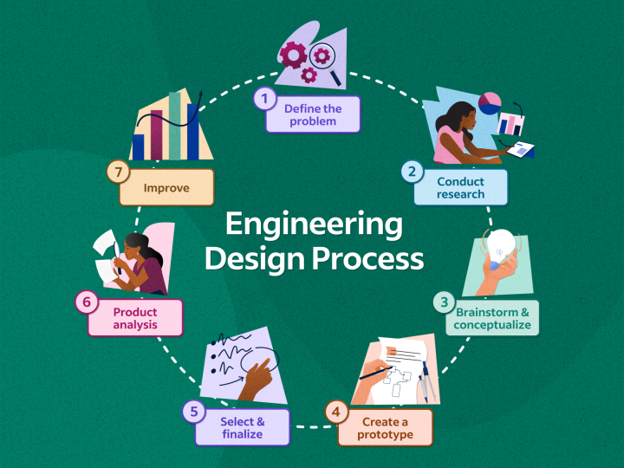

Slide 4
Why Design Thinking?
Design Thinking is not an exclusive property of designers—all great innovators in literature, art, music, science, engineering, and business have practiced it.
The designers’ work processes can help us systematically extract, teach, learn and apply these human-centred techniques to solve problems in a creative and innovative way—in our designs, in our businesses, in our countries, in our lives.

Slide 5
Who All Practice Design Thinking?
Some of the world’s leading brands, such as Apple, Google and Samsung, rapidly adopted the design thinking approach, and leading universities around the world teach the related methodology—including Stanford, Harvard, Imperial College London and the Srishti Institute in India.
Before you incorporate design thinking into your own workflows, you need to know what it is and why it’s so popular. Here, we’ll cut to the chase and tell you what design thinking is all about and why it’s so in demand.

Slide 6
What We Need To Know About Practice Design Thinking?
Design thinking is an iterative process in which you seek to understand your users, challenge assumptions, redefine problems and create innovative solutions which you can prototype and test.
The overall goal is to identify alternative strategies and solutions that are not instantly apparent with your initial level of understanding.
Design thinking is more than just a process; it opens up an entirely new way to think, and it offers a collection of hands-on methods to help you apply this new mindset.

Slide 7
Definition of Design Thinking
Cognitive scientist and Nobel Prize laureate Herbert A. Simon was the first to mention design as a way of thinking in his 1969 book, The Sciences of the Artificial.
He then went on to contribute many ideas throughout the 1970s which are now regarded as principles of design thinking.
Design thinking is an approach used for practical and creative problem-solving through a human-centric approach.
It is based heavily on the methods and processes that designers use (hence the name), but it has actually evolved from a range of different fields—including architecture, engineering and business.
Design thinking can also be applied to any field; it doesn’t necessarily have to be design-specific.

Slide 8
Origins of Design Thinking
Early glimpses of design thinking date back to the 1950s and 1960s
Design ideas as they exist today have evolved collaboratively in various fields and industries.
1963: The idea of using Design as a way of solving complex problems in a simplified manner in sciences originated in the book ‘The science of the Artificial’ authored by Herbert A. Simon
1973: The idea of design was achieved for Design Engineering by the book ‘experiences in visual thinking’ authored by Robert McKim
1982: Design methodology is defined by Nigel Cross (Emeritus Professor of Design Studies at The Open University, UK) as the study of the principles, practices and procedures of design that are developed which includes the study of how designers work and think
1987: Peter Rowes Book Titled “design thinking” describes methods and approaches that planners, designers and architects use

Slide 9
Origins of Design Thinking
1980s to 1990s: The work of Robert McKim was consolidated by Rolf Faste at Stanford university
In 1991 David M Kelly Founded IDEO and adapted Design thinking to business interests
2009: The design thinking process itself is human centered, offering methods for inspiration, ideation and learning to designers
2012: Application of the study of design thinking principles in engineering began.
2015: Verbal protocol analysis(think aloud method), cognitive ethnography, controlled laboratory experiments (nap experiment), and other formal methods from cognitive science have been rigorously applied in engineering
Verbal Protocol Analysis can be used to understand how the operator perceives, operates, or uses a system, product, or space. Also known as the “think aloud” method, the researcher asks an individual to say all thoughts and perceptions that occur while performing a task.
2017: Design thinking reflected in many applications like prototyping. A solution-based method is often a useful way to encourage inspiration, ideation, organized learning and human centric methods

Slide 10
Traits of a Design Thinker in organizations
Driven by empathy: Good design thinkers, along with being responsible for developing innovative and profitable services and strategies, passionately take on the role of championing the cause of the ‘human’. Leaders with the design mindset have the aptitude to listen to the needs of various stakeholders of a project — both within and outside of their organizations — and translate them into workable insights.
Harnessing Innovation: A good design thinker is skilled at harnessing innovation by facilitating collaboration between the people that make up the organization while adding value to each conversation. Profitable innovation happens when there is a ‘merging of the minds’ and the modern leader is a master of collaborative work methods.

Slide 11
Traits of a Design Thinker in organizations
Master of the iterative process: The hallmark of the ‘design way’ is its fluid process that facilitates a journey from chaos and ambiguity to clarity and beauty. The process involves making varied attempts at arriving at the solution while constantly testing and improvising each approach.
Adept at visualizing futures: In today’s technology driven hyper-connected world of social media, crowd funding and the sharing economy, businesses facilitate the redefining of how we live. Organizations that are in the business of creating meaningful trends rather than adapting to norms stay relevant to investors and the people they serve. While research can provide insights into the past and present, it requires creative, constructive imagination to create the future. A good design thinker is inspired to conceptualize desirable future states and has the skills to communicate those visions with clarity.

Slide 12
Principles of Design Thinking
Design thinking is about how to think and act as it is process based.
There are certain tested tools that need to be considered within each mode, each with its own set of inputs, outputs, and well-defined functions.
Apart from the process, design thinking is also about thinking, where the concept can be thought of as an integrated set of beliefs and attitudes.

Slide 13
Principles of Design Thinking
Human Focused Design Thinking: The process that understands from the perspective of the humans including the employees and customers. In this process, the design thinker needs to consider the individuals, their beliefs, values and attitudes.
Diversity to work in a team: Design thinking needs to consider individuals from different backgrounds and train them to work in teams. While group membership should be balanced throughout the project, it may be wise to occasionally include outside-organization participants — such as clients, suppliers, and other professionals — in specific modes or activities.

Slide 14
Principles of Design Thinking
Comprehensive: Although details are important, design experts are also able to identify and consider relationships, collaborations, and communication among seemingly different ideas.
Flexibility and unconventional comfort: Design thinking is best suited to deal with problems and opportunities described in an unintelligible way, and requires great flexibility in terms of both content and methodology
Communication Skills: Willingness to communicate and work in a variety of ways inclusive of speaking, visual, and touch .

Slide 15
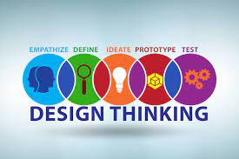
Stages of Design Thinking
We will focus on the five-phase Design Thinking model proposed by the Hasso-Plattner Institute of Design at Stanford (d.school).
D.school is a leading university when it comes to teaching Design Thinking.
The five stages of design thinking, according to d.school, are as follows: Empathy, Define (problem), Ideate, Prototype, and Test.

Slide 16
Empathize
The first step in the design process is to gain a critical understanding of the problem you are trying to solve.
This involves consulting the experts to find out more about the area of concern, to consult and empathize with people to understand their experiences and motives, and to immerse themselves in a visible environment to gain a deeper personal understanding of the issues involved.
Sensitivity is very important in a customer-centric design process like Design thinking, as this allows designers to set aside their ideas about the world in order to gain an understanding of users and their needs.
Depending on the time limit, a large amount of information is collected for use during other phases and to develop a better understanding of users, their needs, and the problems that help in the development of a particular product.

Slide 17
Define
During the Define stage, you combine the information you have created and collected during the empathy phase.
This is where you will analyze what you have seen and put it together to explain the core values that you and your team have identified so far.
You should want to describe the problem as a problem statement in a customer-centric way.
Define Forum will help designers in your team come up with great ideas for creating features, functions, or any other aspects that will allow them to solve problems or, at least, allow users to solve problems themselves with minimal difficulty.

Slide 18
Ideate
During the third phase of the design thinking process, designers are ready to begin producing ideas.
You have grown to understand your users and their needs in the Sensory section, and have analyzed and summarized what you saw in the Define section, and ended up with a problem- focused problem statement.
With this solid domain, you and your team members can start "thinking outside the box" to see new solutions to the problem statement you created, and you can start looking at other ways to look at the problem.
Ideas at the end of the Ideation section help you to investigate and evaluate your ideas to find the best way to solve a problem or provide the necessary features to avoid it.

Slide 19
Prototype
The team of designers will now produce less expensive, discounted versions of the product or specific features found within the product, in order to be able to investigate solutions to problems developed in the previous section.
Prototypes may be shared and tested within the team itself, in other departments, or within a small group of people outside the design team. This is the testing phase, and the aim is to identify the best solution for each problem identified during the first three phases.
Solutions are applied to prototypes, and are individually investigated and adopted, developed and tested, or rejected on the basis of user knowledge.
By the end of this section, the design team will have a better idea of the existing product related problems , and have a clear idea of how real users will behave, think, and feel about the product and services.

Slide 20
Testing
Designers or testers firmly test the complete product using the best solutions identified during the simulation phase.
This is the final stage of a 5-phase model, but with a recurring process, the results produced during the testing phase are often used to redefine one or more problems and inform users' understanding, usage conditions, and how people think. , behave yand be sensitive, and compassionate.
In this phase, changes and improvements are made to solve problems and gain as much insight into the product and its users as possible.

Slide 21
Benefits of Design Thinking
It helps to overcome creative challenges: Design Thinking gives you the freedom to look at problems in many ways. It involves a lot of brains to come up with the best ideas, which helps to improve students ’knowledge.
Helps to meet customer requirements effectively: As discussed earlier, design thinking involves developing prototypes when testing and uses customer feedback repeatedly to ensure quality assurance. By following a successful design idea, the product will eventually meet the needs of customers.
It helps to increase your knowledge of Design Thinking: You will do a lot of experiments in the design thinking process. You will always try to improve your model by using customer feedback to ensure customer satisfaction.

Slide 22
Theories and Practices of Design Thinking
Design scholars continue to discuss theoretical developments in the design thinking.
Different theoretical perspectives have been used in research into design thinking.
one stream of research through protocol analysis to catch the ways designers are making sense of their own working processes.
Another examines methods for teaching design thinking to students through normative decision-based protocol.

Slide 23
Theory of Thinking Modes
Building on the Guilford’s studies there are three basic modes of thinking: Analytical, judicial, and synthetic.
Analytical thinking is the process for separation of things from the visible relationships in the process and production in the organization.
Judicial thinking is comparing and making judgments based on in-depth analysis in the thinking.
Synthetic thinking is the process to combine two things and ideas with the intention of making new process and combination.

Slide 24
Theory of Creative Blocks
According to this theory there are barriers to the creativity of the individual and the individual expresses inability to access creativity and hence the creativity process of the individual gets affected.
Theory of Creative Process
A creative process is the choice between inner and outer, conscious and unconscious mind of the individual through the process of reflection and active collaboration of the individual.

Slide 25
Theory of Creative thinking education and Meta Cognitive Control
According to this theory creative thinking is increased through creative education and supports in creating higher creative achievements among the individuals.
This process also increases the individual creative potential and supports in developing right mindset for creativity of the individual.
Metacognition is an important skill for designers to develop in order to continually improve and optimize their design process.

Slide 26
Practices of Design Thinking
At this stage the processes are presented from the perspective of designers and consultants.
Design ideas from the perspective of designers show that ideas are used for customers problems as this is driven by organizational culture.
Design thinking has an impact on the culture of the organization and therefore designers need to consider the impact of design thinking on the organization.
Design thinking from a consultant's perspective demonstrates that supporting design thinking in providing support for complex business issues thereby providing solutions to complex business problems in the organization.

Slide 27
Team-Based Design Thinking
Building the right type of team plays a key role. Team members from diverse backgrounds and specializations support in providing solutions to the challenges faced by the design team.
Design thinking encourages collaboration, flexibility, curiosity, and positivity, creating happy teams and positively influencing the outcome. Through this process, team members feel valued and clients know that their feedback is taken into consideration.
Right Team Culture is equally important. Involvement of the team members is an important component for developing right culture; hence, rules, regulations and processes of the team have an impact on developing right culture in the team.

Slide 28
Team-Based Design Thinking
Development of higher inclusions, cohesion, interaction and confidence support in developing effective team for design thinking.
Effective communication among the members supports in sharing the ideas and solutions for the design teams in design thinking.
The role of leadership is an important aspect in design thinking. A team leader’s encouragement, supports the design thinking team in the organization to come up with better solutions.

Slide 29
That’s All Folks
Module One is done

